Slide 1
References and Citations

Slide 2
References and Citations
References and citations are integral components of academic and research writing, including technical papers and scholarly articles.
They serve the purpose of acknowledging and providing evidence for the sources of information, data, and prior research that have been used in a document.
Together, citations and references ensure that a document is academically sound, transparent, and credible by attributing credit to original authors and allowing others to access and build upon the cited sources.

Slide 3
Citations
Citations are specific references to sources within the body of the text, indicating where particular information, ideas, or findings have been drawn from.
Citations typically include details such as the author's name, publication year, and page numbers (if applicable). The primary functions of citations are:
To give proper credit to the original authors or sources.
To enable readers to locate and verify the referenced information.
To support the writer's claims or arguments with evidence.
In academic writing, different citation styles are used to format citations in a standardized manner. Some common citation styles include APA, MLA, IEEE, and Chicago, each with its own rules for citing various types of sources.

Slide 4
References
References, also known as a bibliography or works cited (depending on the citation style), are the list of full citations for all the sources cited in a document.
Each entry in the reference list includes complete bibliographic information about the source, such as the author's full name, publication title, journal name, publication date, and other relevant details.
The primary functions of references are:
To provide readers with comprehensive information about the sources.
To facilitate further research or verification of the cited materials.
To demonstrate the depth and breadth of the writer's research and knowledge.
In technical papers and research articles, references are often arranged in a specific order, following the requirements of a particular citation style. These reference lists usually appear at the end of the document and are organized alphabetically or numerically, depending on the style.

Slide 5
Reference Styles
In technical paper writing, referencing styles are essential for properly citing sources and formatting references. The choice of referencing style may depend on the specific field, journal, conference, or institution's guidelines. Here are some common referencing styles used in technical papers:
IEEE (Institute of Electrical and Electronics Engineers) Style: Widely used in engineering, computer science, and related fields, IEEE style features numeric in-text citations and a corresponding numbered list of references. It's known for its simplicity and clarity.
APA (American Psychological Association) Style: Common in the social sciences, psychology, and education, APA style uses author-date in-text citations and includes a detailed reference list with specific formatting rules.
ACM (Association for Computing Machinery) Style: ACM style is used for computer science and information technology papers. It employs numeric in-text citations and a numbered reference list, similar to IEEE style.

Slide 6
Reference Styles
ASME (American Society of Mechanical Engineers) Style: This style is used in mechanical and related engineering fields. It features numeric citations in square brackets and a corresponding numbered reference list.
AMA (American Medical Association) Style: Common in medical and health-related fields, AMA style employs numeric superscript citations in the text and a numerical reference list.
Chicago Manual of Style: This style is versatile and used in various fields. It offers two systems: the notes and bibliography system, which uses footnotes or endnotes and a bibliography, and the author-date system, which includes in-text citations.
Turabian Style: Derived from the Chicago style, Turabian is often used by students and researchers in history, the humanities, and social sciences. It follows similar formatting and citation rules.

Slide 7
Reference Styles
Harvard Referencing Style: Harvard style is a generic author-date system used in various fields. It emphasizes in-text citations and a reference list with author and date information.
Vancouver Style: Predominantly used in the biomedical and life sciences, Vancouver style employs numerical in-text citations in brackets and a corresponding numerical reference list.
CSE (Council of Science Editors) Style: CSE style is often used in the natural and physical sciences. It features in-text citations and a reference list and is known as the "Name-Year" style.
Specific Journal or Conference Styles: Some academic journals and conferences have their own unique citation and formatting styles. Authors should adhere to these specific requirements when submitting papers.
It's crucial to check the guidelines provided by the target publication, conference, or institution to determine which referencing style is preferred. Adhering to the specified citation style ensures that your technical paper complies with academic and publication standards.

Slide 8
Reference management software tool - BibTeX
BibTeX is a reference management software tool and file format used for managing and creating bibliographies in documents, particularly in academic and research writing, such as research papers, theses, and articles.
Database Creation: Users create a BibTeX database (a .bib file) that contains structured entries for each source they want to cite or reference. Each entry contains information about the source, such as its author, title, publication year, journal, and more.
Citation in Document: Within a LaTeX document, authors can include citations to these sources by using a citation command. For example, \cite{AuthorYear}. The citation command corresponds to an entry in the BibTeX database.
Bibliography Generation: At the end of the document, authors insert a command (e.g., \bibliography{database}) that specifies which BibTeX database to use. Then, they use the \bibliographystyle{style} command to specify a particular citation style (e.g., plain, apalike, alpha, etc.).

Slide 9
BibTeX
Compilation: When the document is compiled using LaTeX, BibTeX is called as a separate step. It processes the citations and generates a bibliography section with a list of references in the specified style.
Citation and Bibliography Placement: Within the document, BibTeX citations are replaced with numbered or author-year references, depending on the chosen citation style. The generated bibliography is typically placed at the end of the document.
BibTeX has several advantages:
It allows for easy management and updating of references.
It ensures consistent formatting of references throughout the document.
It automates the process of generating the bibliography section, reducing manual work for the author.
However, BibTeX also has limitations, such as its relative inflexibility compared to more modern reference management tools. Over the years, variants of BibTeX, like BibLaTeX, have been developed to address some of these limitations and offer more flexibility in terms of citation styles and formatting.

Slide 10
Other tools
Zotero: Zotero is a free and open-source reference management tool that allows you to collect, organize, and cite research materials. It offers browser extensions, desktop software, and cloud synchronization.
EndNote: EndNote is a comprehensive reference management software often used in academic and professional settings. It assists in collecting, organizing, and formatting references and citations.
Mendeley: Mendeley is a free reference manager and academic social network. It combines reference management, PDF organization, and collaboration tools. It is widely used in research and academic settings.
RefWorks: RefWorks is a web-based reference management tool used primarily by educational institutions and libraries. It enables users to create, manage, and format citations and references.
Citeulike: Citeulike is a free online service designed for discovering and managing scholarly references. It allows users to store and share references, as well as create and format reference lists.

Slide 11
Other tools
JabRef: JabRef is an open-source reference manager that works with BibTeX. It is particularly popular among LaTeX users for managing references in their research documents.
Citavi: Citavi is a reference management and task planning tool for Windows users. It is popular in academic and research institutions, particularly in German-speaking countries.
Qiqqa: Qiqqa is a reference management software with features for PDF management, annotation, and reference organization. It is designed for researchers and academics.
EndNote Web: EndNote Web is the online version of EndNote, offering reference management and formatting capabilities in a web-based environment.
BibSonomy: BibSonomy is a social bookmarking and reference management system that allows users to collect, organize, and share their references online.

Slide 12
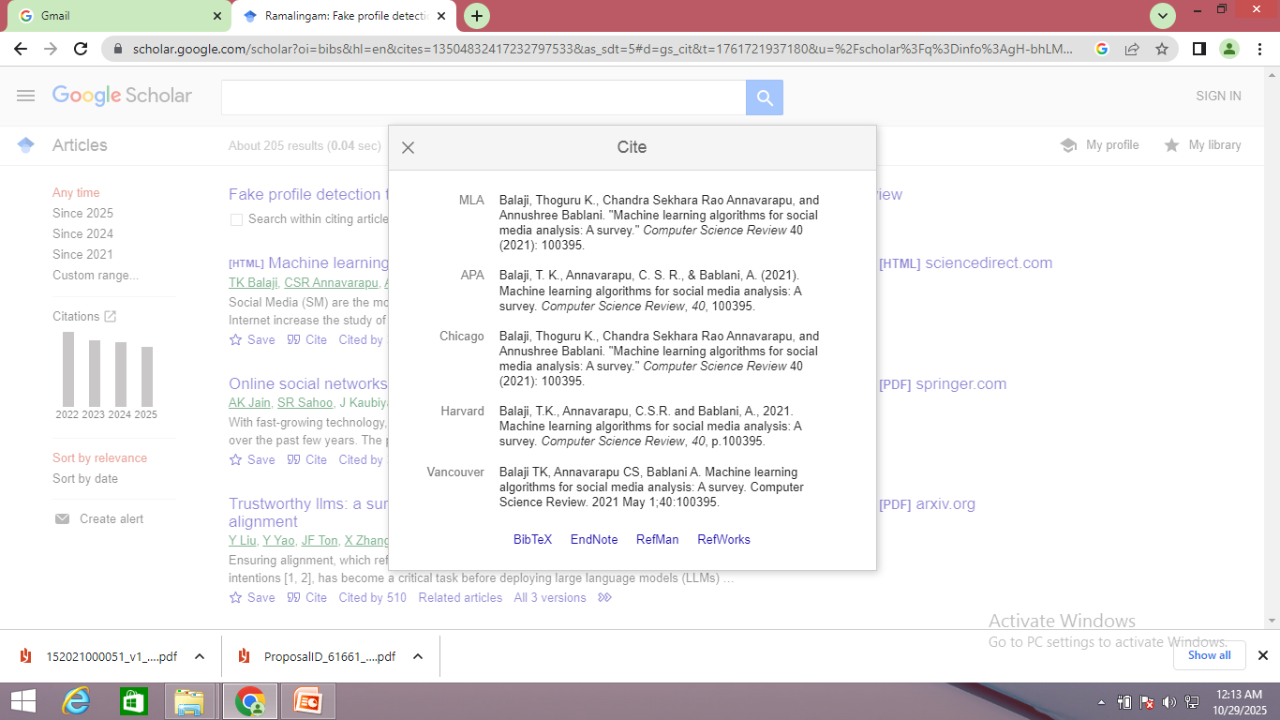

Slide 13
